Slide 1

ECEN 5833
Low Power Embedded Design Techniques

Slide 2


Team CUBIT Rajat Chaple Saloni Shah
cubit - an ancient measure of length, approximately equal to the length of a forearm

Slide 3
Presentation Roadmap
Project Description & Use Cases
System Block Diagram
Hardware Design (Parts, schematic, layout)
Software Design
Low Power Mode Timeline
Simulations
Project Demo
Lessons Learnt

Slide 4
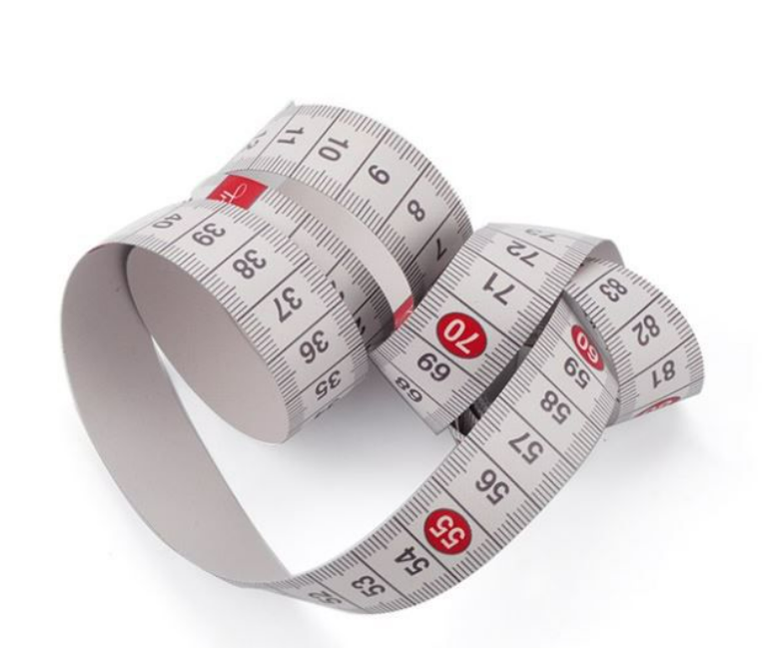
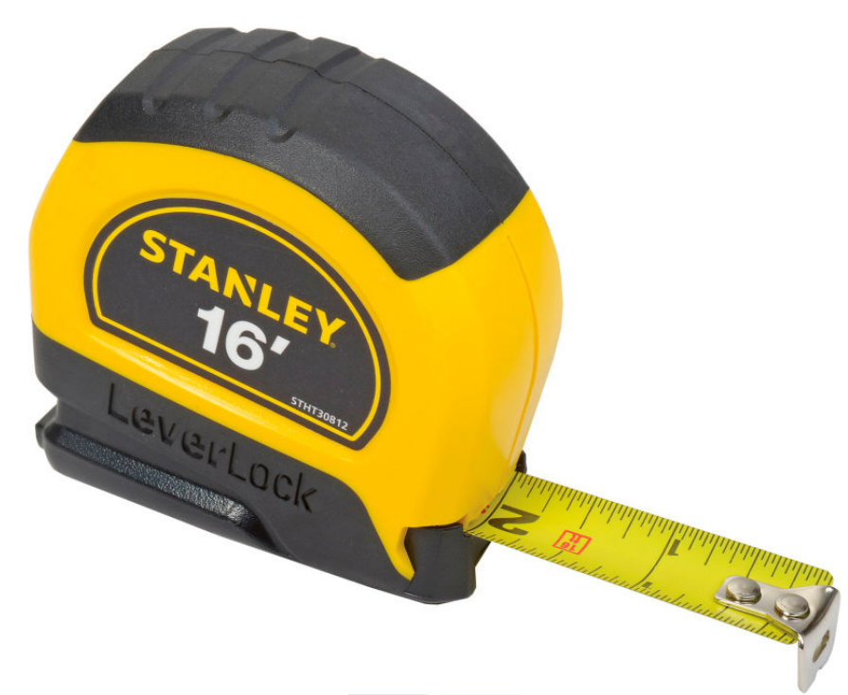
Do you see a problem here?

Slide 5
We have the solution!

Slide 6
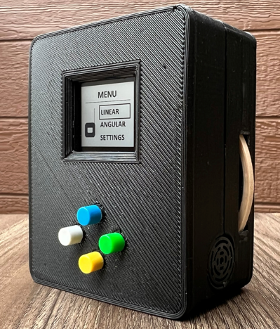
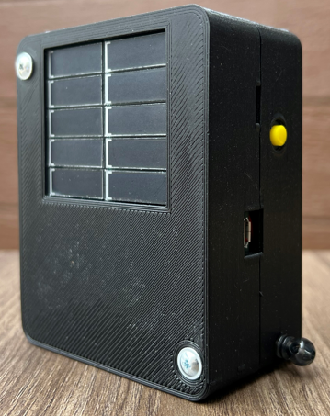
CUBIT
Solar Panel
Power Switch
LCD Display
USB Connector
Wheel
Menu Control
Ultrasonic Sensor
String

Slide 7
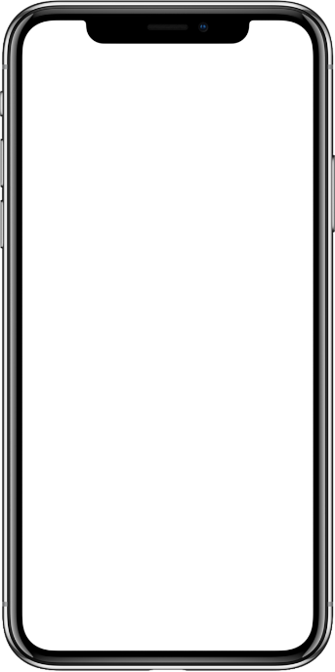
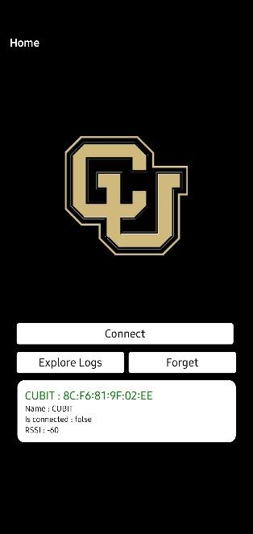

System Block Diagram
UP
DOWN
BACK
SELECT

Slide 8
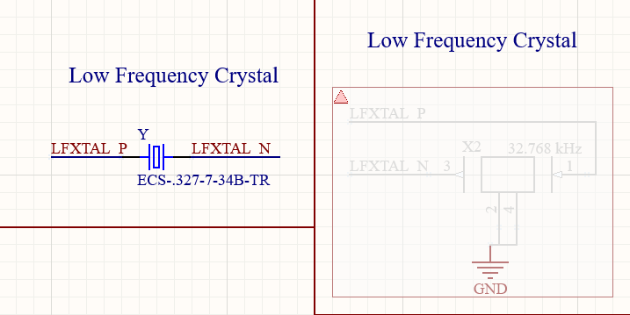
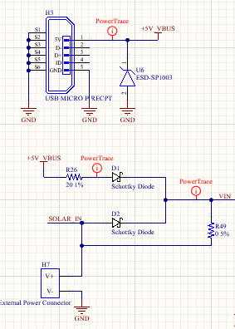
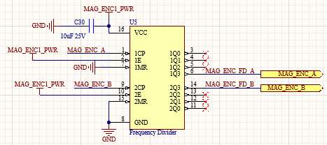
Hardware Design - Schematic
Incorrect low frequency crystal
Frequency divider for magnetic encoder
Circuit for switching between solar and USB

Slide 9
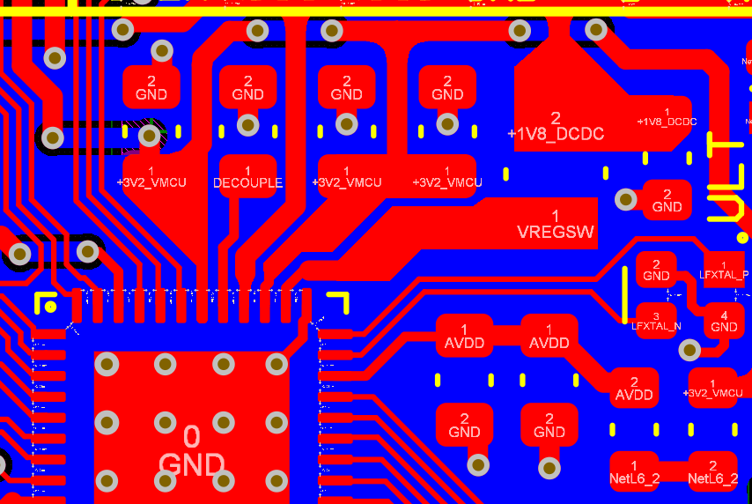
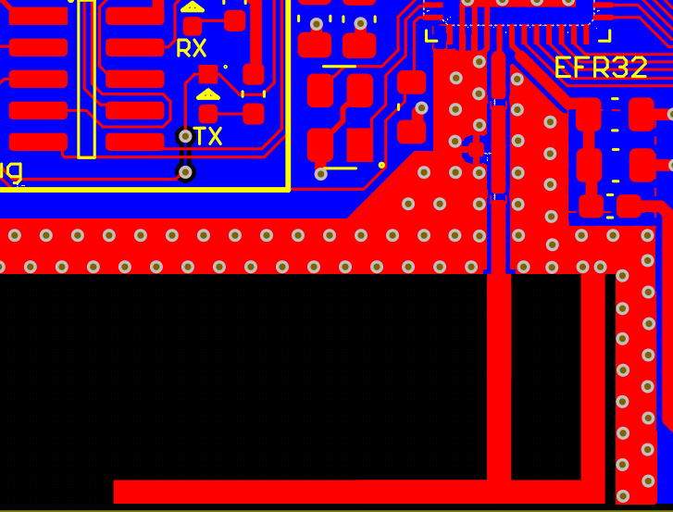
Hardware Design - Layout
Decoupling capacitors for EFR32 power pins
Inverted F-antenna

Slide 10
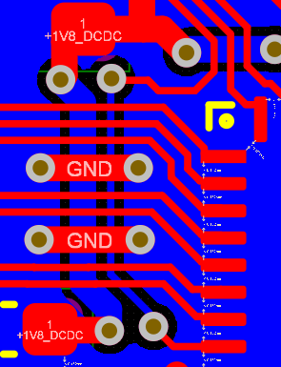
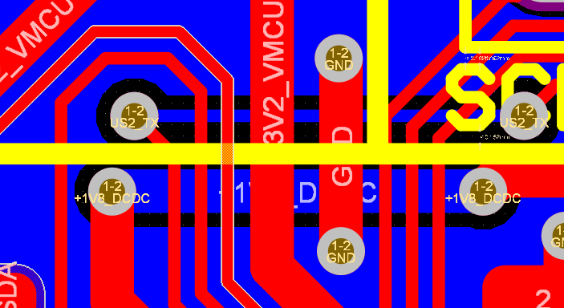
Hardware Design - Layout
Ground staples for a crossover going under multiple signals

Slide 11
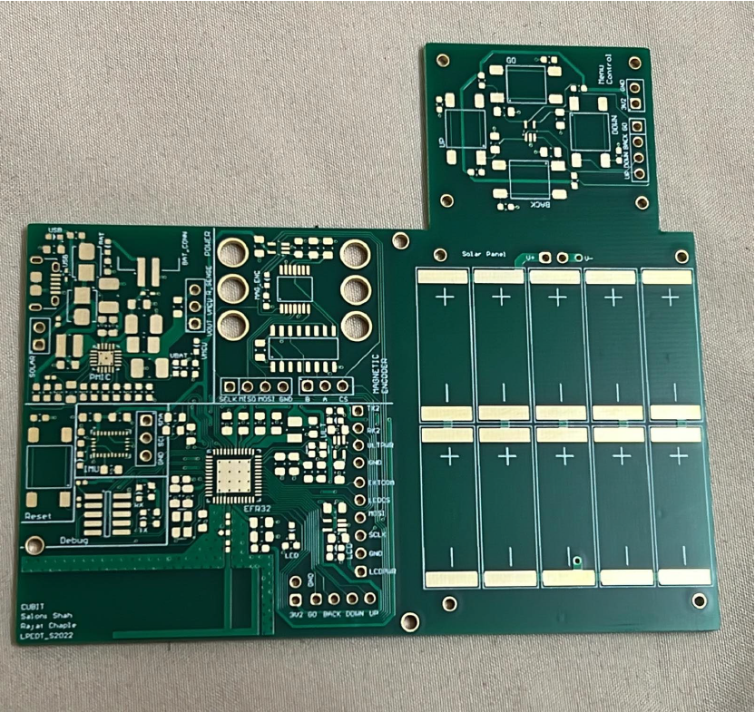
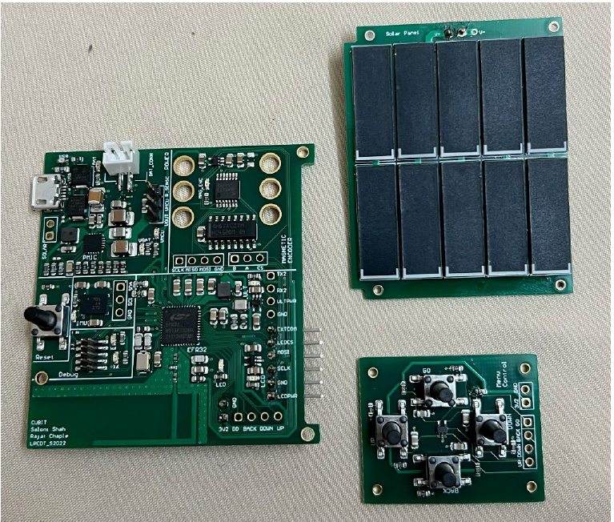
Hardware Design – Assembly

Slide 12
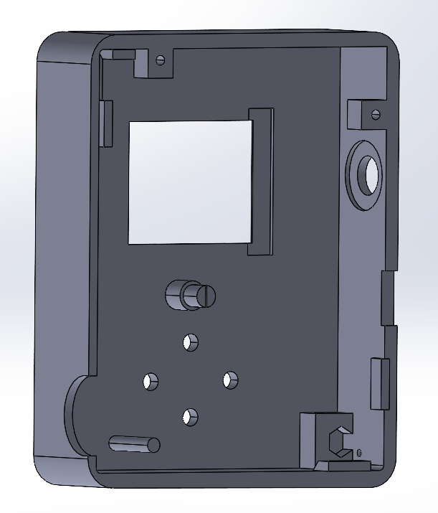
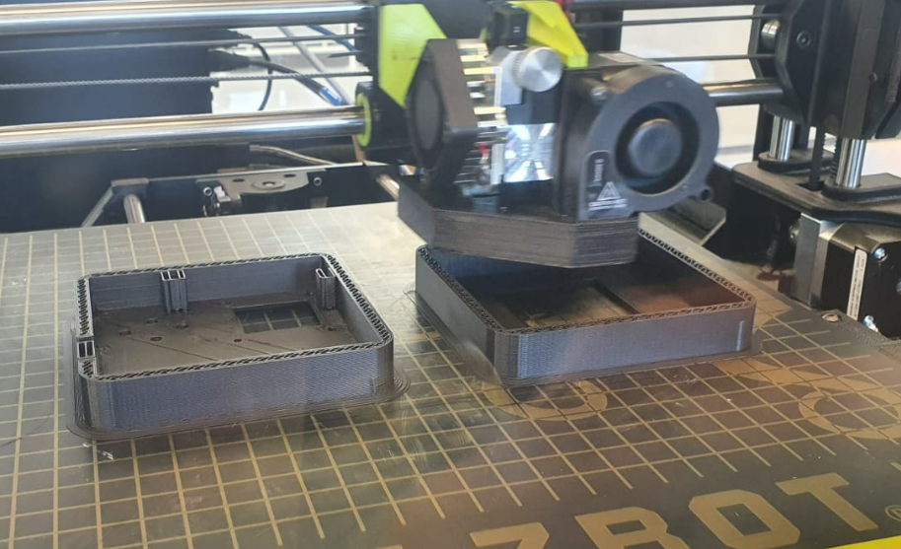
Hardware Design – Assembly

Slide 13
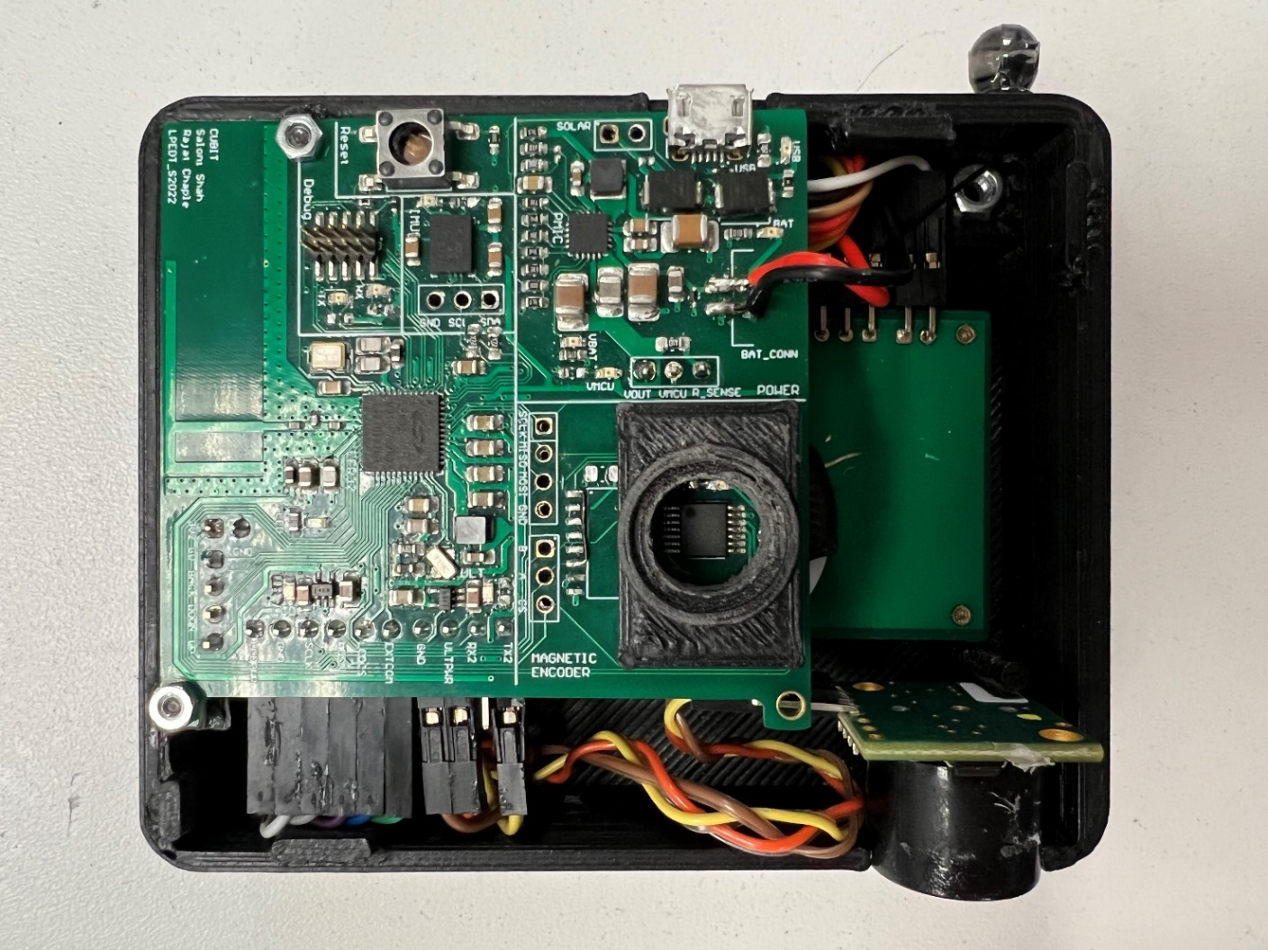
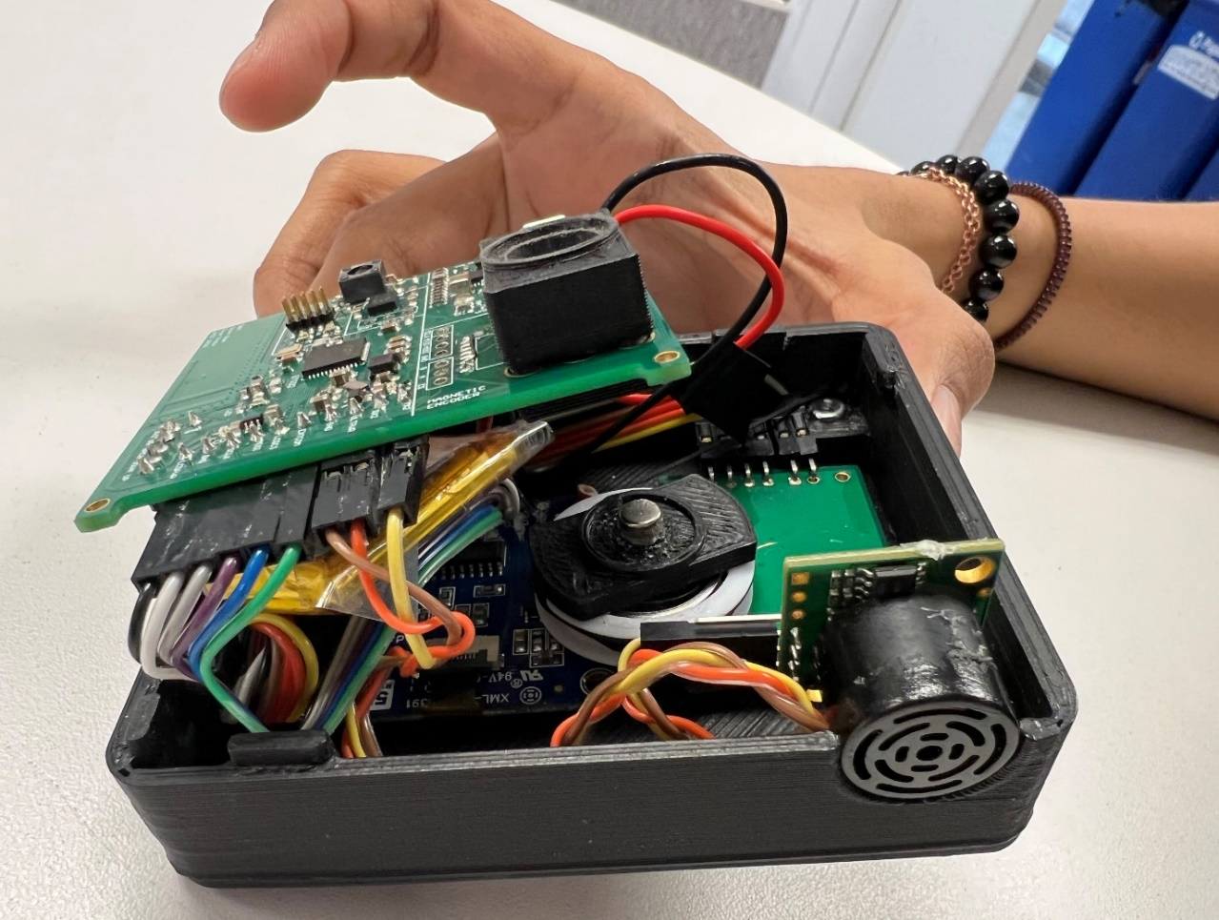
Hardware Design – Assembly

Slide 14
Software Design
MENU
Linear
Angular
Settings
Wheel
Sonic
BNO
Unit
Charge Status
cm
inch
ON
OFF
Magnetic encoder
String
Magnetic encoder
Ultrasonic
LCD and
Control Switches
Send data over Bluetooth

Slide 15
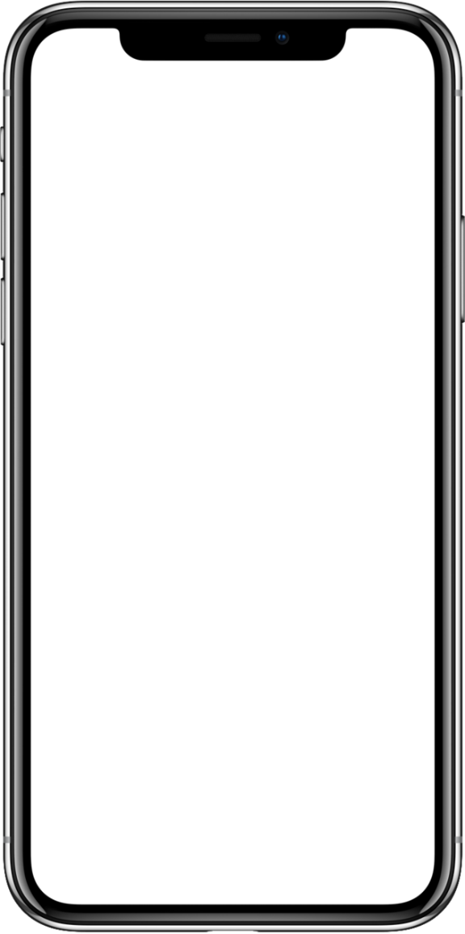
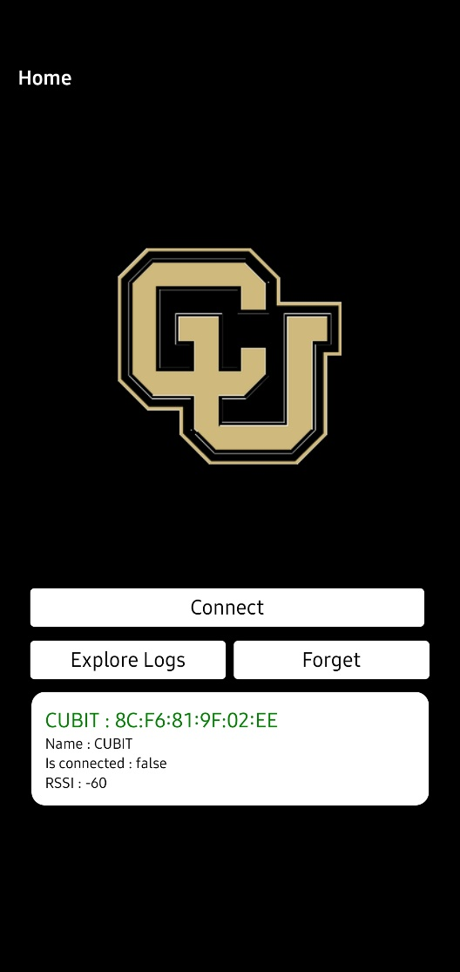
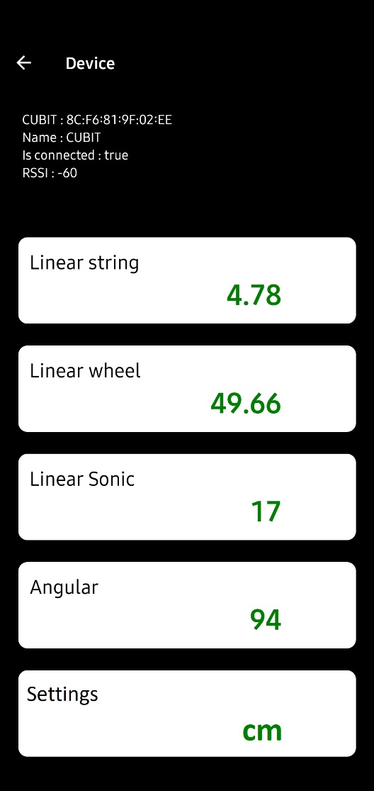
Mobile Application using React Native
React Native - open-source JavaScript Mobile framework
React Native is used with some popular apps like Facebook mobile app, Instagram, Pinterest, Skype, etc.
Example code by https://github.com/Spoutnik97/react-native-arduino-ble-example was modified as per CUBIT requirements

Slide 16
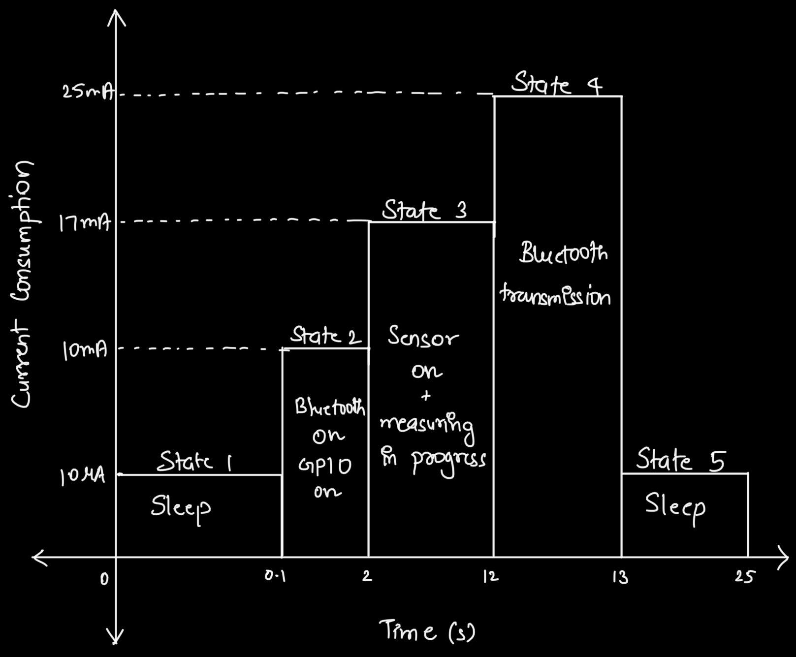
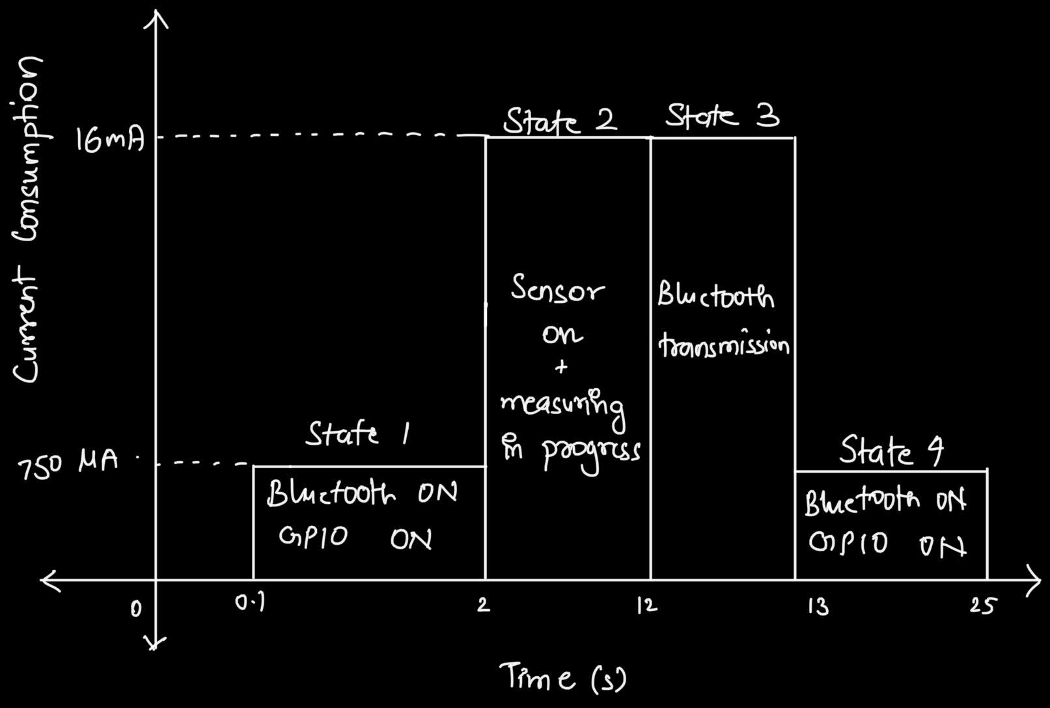
Low Power Mode Timeline
Estimated Energy consumption
Actual Energy consumption

Slide 17
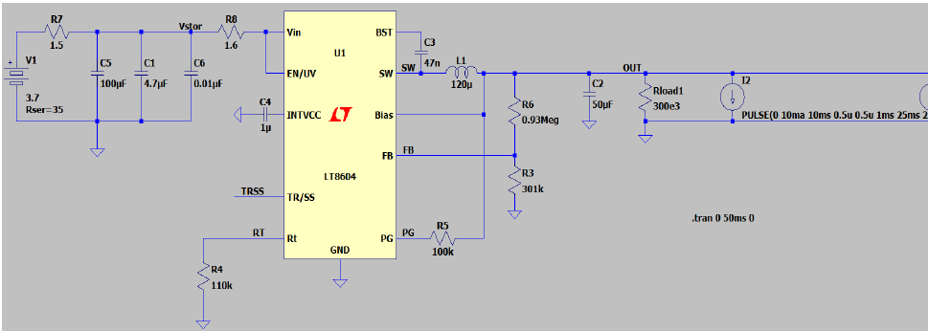
Hardware Simulation
LTspice was used to simulate PMIC IC
Since this chip was no available in the LTspice library, another chip of similar specs was used for simulation

Slide 18
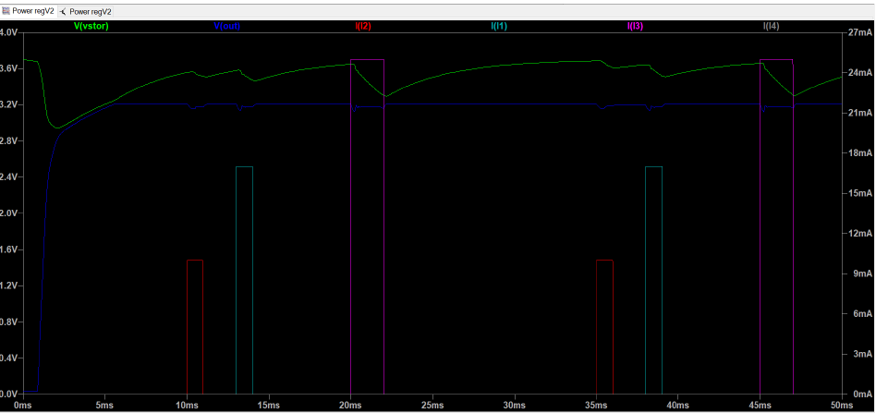
Hardware Simulation
Requirement and value of Bulk capacitor was identified using the LTSPICE simulator
Rectangular block below indicates current surges by sensors at their respective timestamps

Slide 19
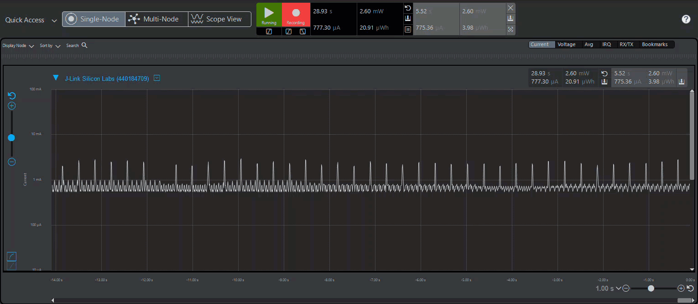
Energy Profiler
● Advertising – 780 uA ● Ultrasonic Sensor – 4.3 mA
● Magnetic Encoder - 16 mA ● IMU sensor – 11 mA

Slide 20
Project Demo

Slide 21
Lessons Learned
Always double check before finalizing a component
- We used the incorrect low frequency crystal which had to be changed later
For mechanical assembly, super glue, double-sided tape and filler are your best friends
Plan your work and work your plan
Keep backup of your backup plan
Shorter way to do many things is to only do one thing at a time
Teamwork makes the dream work

Slide 22
THANK YOU

